Slide 1
UNIT:6 MEMORY MANAGEMENT & VIRTUAL MEMORY

Slide 2
LECTURE OVERVIEW
Basic concept
Logical and Physical address map
Memory allocation
Paging
Basics of Virtual Memory
Page fault
Working Set
Dirty page/Dirty bit
Page Replacement algorithms:

Slide 3
Memory Management
Memory Management is an important characteristic of the Operating System. This comes beneath one of the two main capabilities of an Operating System, useful resource management. Main memory (RAM) is where maximum of the programs run. It is one of the most important matters people search for whilst buying a new cellphone or a new laptop.

Slide 4
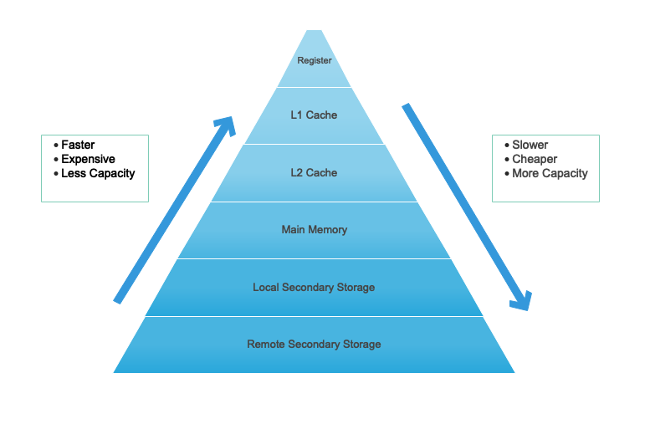
In computer system architecture memory Hierarchy is part to arrange the memory in a such a way it can minimize access time.
What is Memory Hierarchy?

Slide 5
Logical and Physical Address
Logical address is CPU generated address and it generate while program is running
It considers as a virtual address and it not exist physically.
It use as a reference for access Physical memory point by CPU.
In a memory physical location identifies by Physical address.
Physical address not directly access by the user but it can be accessible by its corresponding logical address.
The term Physical Address Space is utilized for every physical location relating to the logical addresses in a Logical location space.
MMU computes Physical address

Slide 6
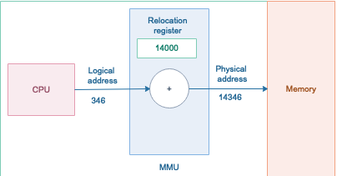
Memory-Management Unit (MMU)
It is a hardware device which uses to map virtual address to physical address.

Slide 7
Binding of Instructions and Data to Memory
Compile time. Helps to convert symbolic addresses to absolute addresses. If you know at compile time where the process will reside in memory, then absolute code can be generated (Static).
Load time. The compiler translates symbolic addresses to relative addresses. The loader translates these to absolute addresses. If it is not known at compile time where the process will reside in memory, then the compiler must generate relocatable code (Static).
Execution time. If the process can be moved during its execution from one memory segment to another, then binding must be delayed until run time. The absolute addresses are generated by hardware. Most general-purpose OSs use this method (Dynamic).

Slide 8
Absolute code: It is a code and data which will placed where you insist assembler to be placed.
Reloadable code: Can load anywhere in memory it generally divide into control section and all memory address are expressed relative to the start of a control section.

Slide 9
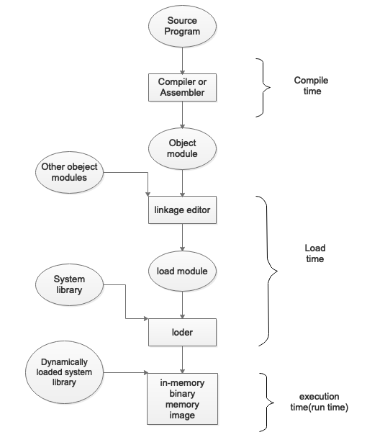
Multistep processing of user program

Slide 10
Memory Management Requirements
Relocation : when program get execute programmer does not know where the program will be placed in memory.
It may be swapped to disk and get return into main memory at different location while the program is executing.
Memory references must be translated in the code to actual physical memory address
Protection: process need permission to reference memory locations into another process.
At compile time It is impossible to check absolute addresses
Checked at run time.

Slide 11
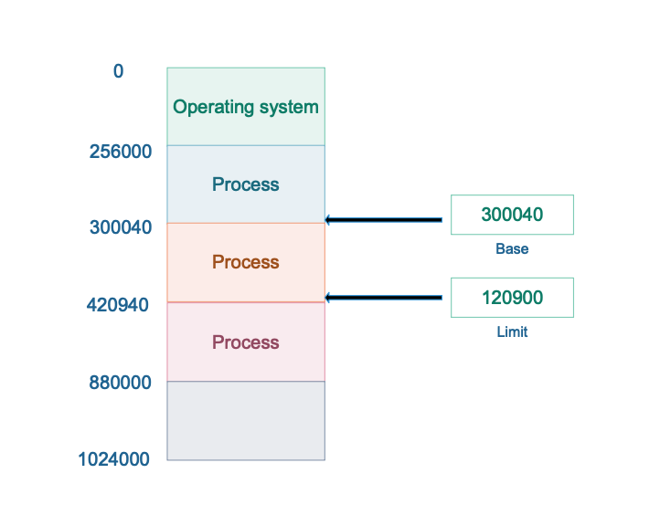
Base and Limit register: Memory Protection
Set of address that a process can use to address memory called an address space. It is range od valid addresses in a memory which are available for a program or process.
Start address of program is base register.
Length of program is limit register.
Base and limit register only modify by OS

Slide 12
Hardware Address protection using base and limit registers: Dynamic relocation
Assurance of memory space is practiced by having CPU equipment think about each address produced in client mode with the registers.
Any endeavor by client program running in client mode to get to the memory space of the working framework or some other client program, brings about a trap.
This plan restricts a client program from adjusting the code or information structure of the working framework or other client programs.

Slide 13
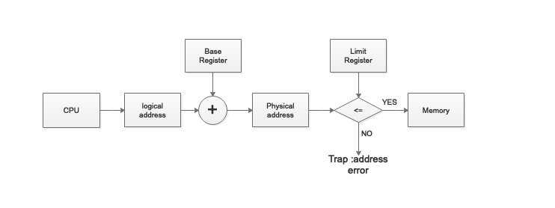
Steps in dynamic relocation
Equipment includes migration register (base) to the virtual location to get a physical location.
Equipment contrasts address and breaking point register; the location must be not exactly or equivalent cutoff.
In the event that the test falls flat, the processor takes a location trap and overlooks the physical location.

Slide 14
Static vs Dynamic Loading
Static | Dynamic
1.Entire program load into main memory before program start execution. | 1.On demand it load program into memory
2.Memory utilization is inefficient because it require or not it load whole program into main memory. | 2. Memory utilization is efficient because it load program on demand.
3. Fast execution of program | 3. Slower execution of program
4. Every time it takes load time when program load into main memory | 4. Perform at a run time by operating system
5. Static linking is applied if the static loading used accordingly | 5. dynamic linking is applied if the dynamic loading used accordingly
6.To start execution absolute data and program load into memory | 6. Bit by bit loading of data and information in run time

Slide 15
Swapping
For temporarily any process can be swapped out of memory to backing store and take back into memory for further execution.
Backing store – disk large enough so that can accommodate copies of all memory images for all users.
Roll out roll in- for priority based scheduling algorithm swapping variant used; to load high-priority process and to get execute lower priority process need to swapped out.
Ready queue maintain by the system for ready -to-run processes which have memory images on disk.

Slide 16
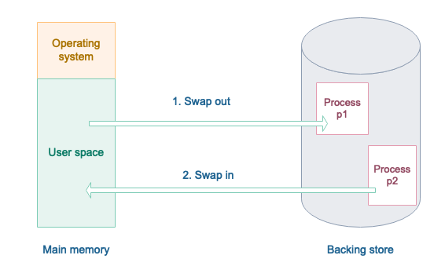
Schematic View of Swapping

Slide 17
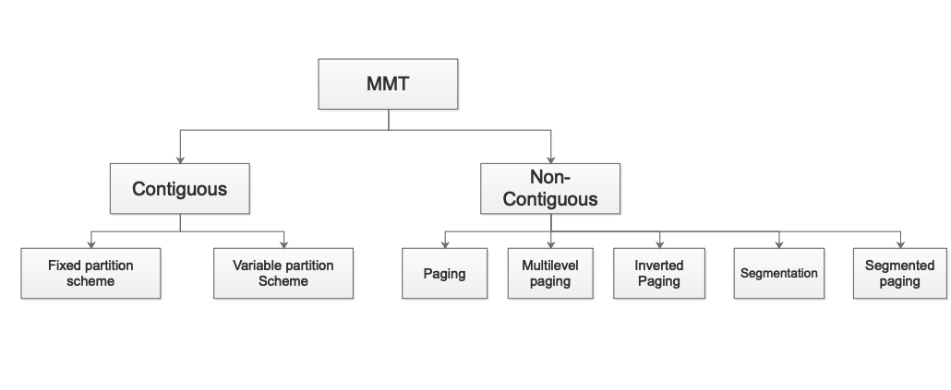
Memory Management Techniques (MMT)

Slide 18
Topics:
Memory Allocation: Contiguous Memory Allocation.
Fixed and Variable Partition.
Internal and External Fragmentation and Compaction.
Paging: Principle of Operation.
Page Allocation.

Slide 19
Memory Allocation: Contiguous Memory Allocation :
Memory allocation is a mechanism by which computer programs and services are assigned with physical or virtual memory space.
Memory allocation is the process of reserving a partially or entirely portion of computer memory.
There are 2 types of memory allocation:
Contiguous memory allocation
2. Non – Contiguous memory allocation

Slide 20
Contiguous Memory Allocation:
Contiguous memory allocation is known as a memory allocation model in which a single contiguous adjacent area is allocated in the memory for each program.
When a process needs to execute, memory is requested by the process.
The size of the process is compared with the amount of contiguous main memory available to execute the process.
If enough contiguous memory is found, the process is allocated memory to start its execution.
Otherwise, waiting processes are added to a queue until there is sufficient free contiguous memory available.

Slide 21
Contiguous Memory Allocation:
In operating systems, the contiguous memory allocation scheme can be implemented with the aid of two registers, known as base and limit registers.
Main memory usually has two partitions :
Low Memory : Operating system resides in this memory.
High Memory : User processes are held in high memory.

Slide 22
Contiguous Memory Allocation:
Partitioning of memory can be done in the following ways:
1. Single Process Monitor
2. Multiprogramming with Fixed Partition
3. Multiprogramming with Variable Partition

Slide 23

Single Process Monitor :
Main memory is dividing into the two parts. One is part of O.S. and second for user process area.
0
400MB
1000MB
Figure - 1 Single Process Monitor[2]

Slide 24
Single Process Monitor :
For example: Here main memory 0-400MB space is reserve for the Operating System.
Second part is part for user process in which user’s process will be loaded into memory.
Only one process can load to memory in Single Process Monitor. The next process will be loaded into memory when one process is complete.
Single process monitor does not support multiprogramming but only supports uniprogramming.

Slide 25
Multiprogramming with Fixed Partition (MFT):
The main memory is divided into multiple partitions to support the multiprogramming.
The number of partitions are fixed but the size of each partition can be different.
Each process will store into these partitions contiguously.
Here only one process is allowed into one partition.
The degree of multi-programming is equivalent to the number of partitions as there can be many processes in the main memory at one time.

Slide 26

Multiprogramming with Fixed Partition (MFT):
In fig.1 memory is divided into 5 equal size partitions. Each partition of 100MB.
0
500
600
700
800
900
1000
Figure - 2 Multiprogramming with Fixed Partition[2]

Slide 27
Multiprogramming with Fixed Partition (MFT):
Advantages of Fixed Partition:
Easy to implement.
Little OS overhead.
Disadvantages of Fixed Partition:
Internal Fragmentation
External Fragmentation
Limit process size
Limitation on Degree of Multiprogramming

Slide 28

Multiprogramming with Variable Partition(MVT):
Partitions are created dynamically to avoid the difficulties of the fixed partitions.
No partition is fixed in memory in dynamic partitions, but the partition is only created when the process is loaded into memory.
0
500
650
750
800
1000
Figure - 3 Multiprogramming with Variable Partition[2]

Slide 29
Multiprogramming with Variable Partition(MVT):
In figure above memory is divide into 4 unequal size partitions. Partition size is not equal.
Here the not problem of internal fragmentation. But here the problem of external fragmentation.
Advantages of Variable Partition:
No internal fragmentation.
Efficient use of memory.
Disadvantages of Variable Partition:
Problem of external fragmentation.
Not easy to implement.

Slide 30
Problems with fixed partitioning:
Main problem with this arrangement is fragmentation.
Fragmentation is the presence of unusable areas in the computer memory
There are two types of Fragmentation
1. Internal Fragmentation
2. External fragmentation

Slide 31
Internal Fragmentation:
Internal fragmentation occurs when the memory is divided into fixed sized blocks.
Whenever a process request for the memory, the fixed sized block is allocated to the process.
In case the memory assigned to the process is somewhat larger than the memory requested, then the difference between assigned and requested memory is the Internal Fragmentation.
Internal fragmentation occurs when fixed sized memory blocks are allocated to the process without concerning about the size of the process

Slide 32
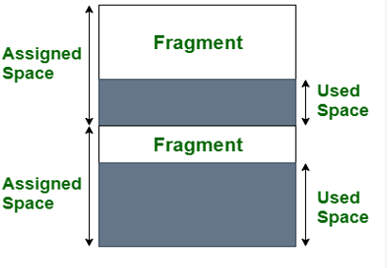
The above diagram clearly shows the internal fragmentation because the difference between memory allocated and required space or memory is called Internal fragmentation.
Internal Fragmentation:
Figure - 4 Multiprogramming with Variable Partition[6]

Slide 33

Example of Internal Fragmentation:
Here p1, p2,p3,p4 is loaded into memory.
Process P1 is loaded into first partition whose size is 150MB and size of process P1 is 110MB ,so in partition 40MB space is waste.
This is called Internal Fragmentation,
0
500
650
750
800
1000
Figure - 5 Example of Internal Fragmentation [6]

Slide 34
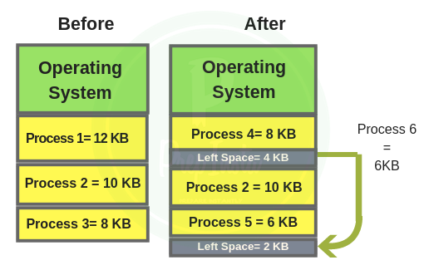
External Fragmentation:
When the process is loaded or removed from the memory, a free space is created. This free space creates an empty space in the memory which is called external fragmentation.
Figure - 6 Example of Internal Fragmentation [1]

Slide 35
External Fragmentation:
When the memory assigned to the process dynamically based on process request.
Memory is partitioned into variable size blocks.
External fragmentation can be eliminated by compaction, paging, and segmentation so that memory can be allocated in a non-contiguous manner to a process.

Slide 36
Compaction:
Compaction is one of the technique to avoid External Fragmentation.
Move all the processes towards the top or towards the bottom to make free available space in a single contiguous block is known as compaction.
Compaction is undesirable to implement because it interrupts all the running processes in the main memory
The other technique to avoid external fragmentation is to implement non-contiguous memory allocation techniques

Slide 37
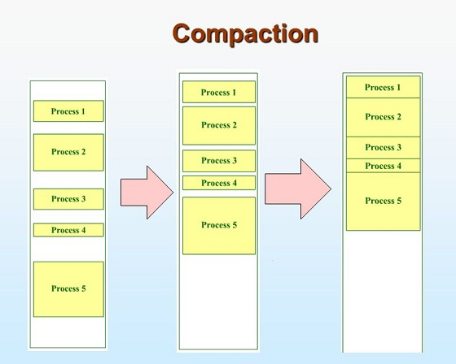
Example of Compaction:
Figure - 7 Example of Internal Fragmentation [6]

Slide 38
Paging: Principle of Operation
In Operating Systems, Paging is a storage mechanism used to retrieve processes from the secondary storage into the main memory in the form of pages.
The main idea behind the paging is to divide each process in the form of pages.
The main memory will also be divided in the form of frames.
One page of the process is to be stored in one of the frames of the memory.
The pages can be stored at the different locations of the memory, but the priority is always to find the contiguous frames or holes. Different operating system defines different frame sizes.

Slide 39
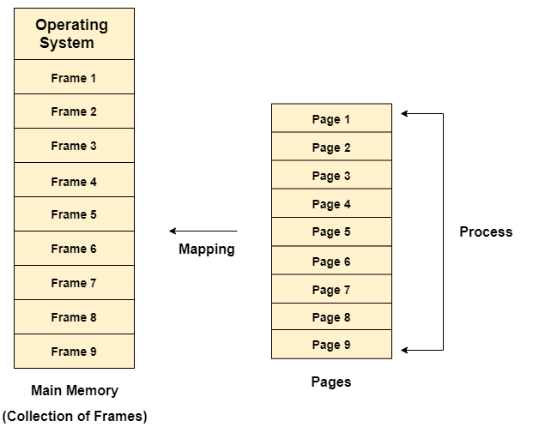
Paging: Principle of Operation
The sizes of each frame must be equal. Considering the fact that the pages are mapped to the frames in Paging, page size needs to be as same as frame size.
Figure - 8 Paging [4]

Slide 40
Example of Paging:
Let us consider the main memory size 16 Kb and Frame size is 1 KB therefore the main memory will be divided into the collection of 16 frames of 1 KB each.
There are 4 processes In the system that is P1, P2, P3 and P4 of 4 KB each.
Each process is divided into pages of 1 KB each so that one page can be stored in one frame.
Initially, all the frames are empty therefore pages of the processes will get stored in the contiguous way.

Slide 41
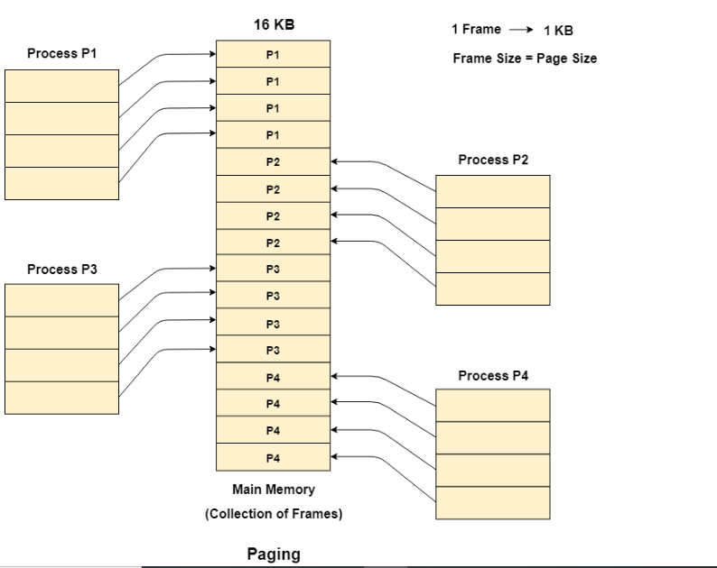
Figure - 9 Example of Paging[4]

Slide 42
Example of Paging:
Let us consider that, P2 and P4 are moved to waiting state after some time.
Now, 8 frames become empty and therefore other pages can be loaded in that empty place.
The process P5 of size 8 KB (8 pages) is waiting inside the ready queue.
Given the fact that, we have 8 non contiguous frames available in the memory and paging provides the flexibility of storing the process at the different places. Therefore, we can load the pages of process P5 in the place of P2 and P4.

Slide 43
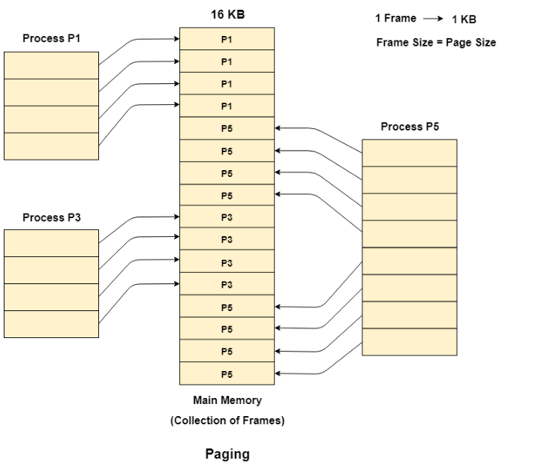
Figure - 10 Example of Paging[4]

Slide 44
Memory Management Unit:
The purpose of Memory Management Unit (MMU) is to convert the logical address into the physical address.
The logical address is the address generated by the CPU for every page while the physical address is the actual address of the frame where each page will be stored.
The purpose of Memory Management Unit (MMU) is to convert the logical address into the physical address.
The logical address is the address generated by the CPU for every page while the physical address is the actual address of the frame where each page will be stored.

Slide 45
Memory Management Unit:
The logical address has two parts:
1. Page Number
2. Offset
Memory management unit of OS needs to convert the page number to the frame number.

Slide 46
Physical Address Space:
Physical address space in a system can be defined as the size of the main memory.
It is really important to compare the process size with the physical address space. The process size must be less than the physical address space.
Syntax of Physical Address Space is:
Physical Address Space = Size of the Main Memory

Slide 47
Example of Physical Address Space:
If, physical address space = 64 KB = 2 ^ 6 KB = 2 ^ 6 X 2 ^ 10 Bytes = 2 ^ 16 bytes
Let us consider,
word size = 8 Bytes = 2 ^ 3 Bytes
Hence,
Physical address space (in words) = (2 ^ 16) / (2 ^ 3) = 2 ^ 13 Words
Therefore,
Physical Address = 13 bits

Slide 48
Logical Address Space:
Logical address space can be defined as the size of the process. The size of the process should be less enough so that it can reside in the main memory.
For Example of Logical Address Space is:
Logical Address Space = 128 MB = (2 ^ 7 X 2 ^ 20) Bytes = 2 ^ 27 Bytes
Word size = 4 Bytes = 2 ^ 2 Bytes
Logical Address Space (in words) = (2 ^ 27) / (2 ^ 2) = 2 ^ 25 Words
Logical Address = 25 Bits
What is a Word?
The Word is the smallest unit of the memory. It is the collection of bytes. Every operating system defines different word sizes after analyzing the n-bit address that is inputted to the decoder and the 2 ^ n memory locations that are produced from the decoder.

Slide 49
Page Table:
Page Table is a data structure used by the virtual memory system to store the mapping between logical addresses and physical addresses.
Logical addresses are generated by the CPU for the pages of the processes therefore they are generally used by the processes.
Physical addresses are the actual frame address of the memory.
They are generally used by the hardware or more specifically by RAM subsystems.

Slide 50
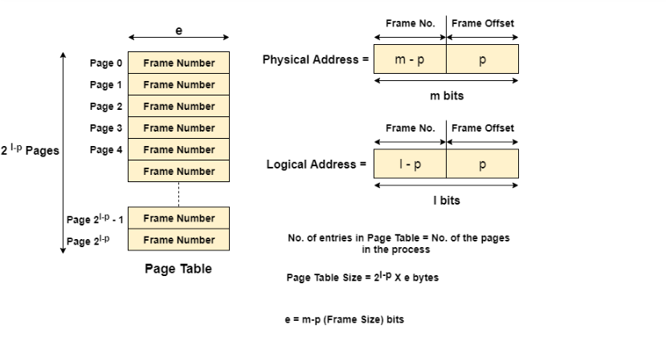
Representation of Physical and Logical Address:
Figure - 11 Representation of Physical and Logical Address [3]

Slide 51
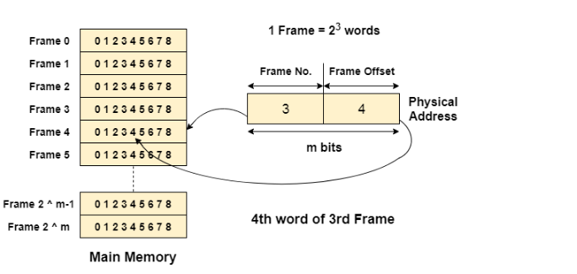
Example of Page Table:
Figure - 12 Example of Page Table[3]

Slide 52
Mapping From Page Table To Main Memory:
In operating systems, there is always a requirement of mapping from logical address to the physical address.
However, this process involves various steps which are defined as follows.
Step 1: Generation of logical address
Step 2: To determine the actual page number of the process, CPU stores the page table base in a special register. Each time the address is generated, the value of the page table base is added to the page number to get the actual location of the page entry in the table. This process is called scaling.

Slide 53
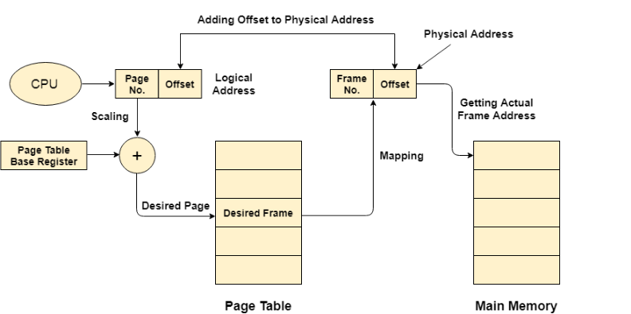
Mapping From Page Table To Main Memory:
Step 3:Generation of physical Address
Step 4: Getting Actual Frame Number
Figure – 14 Mapping From Page Table to Main Memory [3]

Slide 54
Page Allocation:
Paged allocation in memory management divides computer physical memory (Random Access Memory – RAM) into fixed size of memory units called page frames (memory block size).
Also divides virtual address space to size of the pages.
The main advantage of using paged allocation is, an empty page frame can be used by any job however, need to keep track of number of pages and where the pages of individual job are located in memory.
In other words memory can be used efficiently and each job runs on its own address space. Frames, pages and the mapping between the two is shown in the .

Slide 55
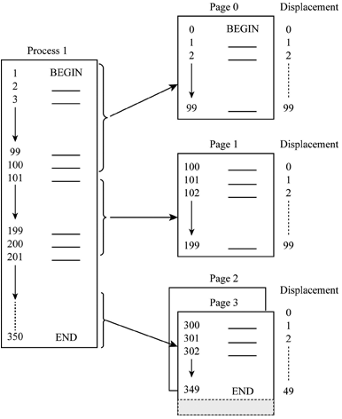
Example of Page Allocation:
Figure - 15 Example of Page Allocation [5]

Slide 56
Page Allocation:
From figure, the size of each page is 100 memory locations.
The memory utilized by the process1 in the given figure is 350 memory locations where it takes 4 pages to store 350 memory locations.
That is, in memory block 0 or page 0 holds first 100 memory locations of data.
In second page, memory locations of 100 to 199 are stored and so on.

Slide 57
Steps to determine exact location of the instruction or code line:
Find the page number and displacement.
Determine memory block size which contains required page.
Obtain the address of beginning of the first memory block.
Add the displacement to starting address of memory blocks if the required page is in other than page 0.
When the system moves required pages from main memory to secondary memory it gives rise to demand paging, in other words, moving only the required page to physical memory.

Slide 58
Hardware support for paging, Protection and sharing Disadvantages of paging. Virtual Memory: Basics of Virtual Memory – Hardware and control structures Locality of reference, Page fault, Working Set, Dirty page/Dirty bit
Topics:

Slide 59
Each OS has its own method for storing page tables. page table for each process is there. Pointer to the page table is stored with other register values in PCB. The h/w implementation of page table can be done in several ways. 1) The page table is implemented as a set of dedicated registers. The use of registers for the page table is satisfactory if the page table is reasonably small. But current systems have Page table size that is very large, so use of only registers is not feasible.
Hardware Support

Slide 60
2) Using Translation look-aside buffer (TLB). The problem with previous approach is the time required to access a memory, with this scheme 2 memory access required like, a P.T. is kept in main memory, and a page- table based register (PTBR) points to the page table. The standard solution to this problem is to use a special, small, fast-lookup hardware, called translation look-aside buffer (TLB).
Hardware Support

Slide 61
TLB(Translation Look-aside Buffer )
It is associative, high speed memory.
Each entry in TLB consists of 2 parts:
a key (tag)
a value.
TLB used with P.T. in following way:
It contains a few of the page-table entries.
When a logical address is generated by the CPU, its page no. is presented to the TLB.
If the page no. is found in TLB, its frame no. is immediately available and is used to access memory.
If the page no. is not in TLB (known as TLB miss), a memory reference to the page table must be made.
When the frame no. is obtained, we can use it to access memory.

Slide 62
TLB(Translation Look-aside Buffer )
Example:-
A CPU generates 32-bit virtual addresses. The page size is 4 KB. The processor has a translation look-aside buffer (TLB) which can hold a total of 128 page table entries and is 4-way set associative. Calculate the minimum size of the TLB tag.
Answer:-
Size of a page = 4KB = 2^12
Total number of bits needed to address a page frame = 32 – 12 = 20
If there are ‘n’ cache lines in a set, the cache placement is called n-way set associative.
Since TLB is 4 way set associative and can hold total 128 (2^7) page table entries, number of sets in cache = 2^7/4 = 2^5.
So 5 bits are needed to address a set, and 15 (20 – 5) bits are needed for tag.

Slide 63
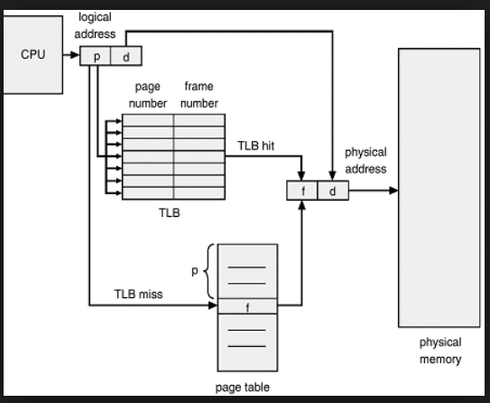
Paging hardware with TLB
Fig. Paging hardware with TLB[1]

Slide 64
Paging hardware with TLB(Cont’d..)
Now add that page no. and frame no. into TLB so that next time it would be helpful to access a physical memory.
If the TLB is full of entries, some of them can be removed. This decision has been taken by using LRU algorithm.
Some TLBs allowed entries to be wired down that means it can’t be removed.
Some TLBs store address-space identifiers (ASIDs) in each TLB entry.

Slide 65
Paging hardware with TLB(Cont’d..)
ASID –uniquely identify each process and used to provide address space protection to corresponding process.
It ensures that the ASID for the currently running process must matches with the virtual page that it is now resolving.
If it doesn’t match , it is known as TLB miss.
An ASIDs allow TLB to contains different process simultaneously.
If the TLB does not support separate ASIDs, then every time a different page table is selected, and the previous TLB must be erased.

Slide 66
Paging hardware with TLB(Cont’d..)
The percentage of times that a page is found in TLB is known as hit ratio.
For Example:-
80 % hit ratio means we find desired page in 80 percent of time.
It takes 20 nanosecond to search the TLB and 100 nanoseconds to access memory. So mapping requires total 120 nanoseconds total.
If its not in TLB then, 20 ns for TLB search, 100 ns for memory access for page table, then 100 ns for mapping, so total 220.
Effective Access time = (0.80 *120) + (0.20 * 220)
= 140 ns
Example:- 2
If hit ratio increase as 98 %
Effective Access time = (0.98 *120) + (0.02 * 220)
= 122 ns

Slide 67
Advantages of Paging
Memory allocation and de-allocation is very fast.
It is noncontiguous memory allocation so we do not require contiguous memory space for one process.
No external fragmentation problem.
Swap-in and Swap-out operations are performed fast.

Slide 68
Disadvantages of Paging
This technique is suffering with internal fragmentation.
For Example:-
If pages are 120 bytes, a process of 400 bytes requires 3 pages + for 40 bytes it requires again 1 page. So total 4 pages will be allocated.
(120-40) = 80 bytes size will be free and its internal fragmentation.
It requires more size of memory to store page table. As the page number increases the page table size is increase.

Slide 69
Memory Protection
Memory protection in paging must be required. That is frame allocated to the one page cannot be reallocated to other page meanwhile one page is allocated to it.
This memory protection can be performed by using one special bit associated with each frame, and stored in page table, that is Protection Bit.
Page table has index starting from 0 to maximum allowed page in memory.
But we are not using all pages at a time so to find out which page is used and write now present in memory and which is not we are using one special bit that is known as Valid/Invalid bit as shown in fig.
Instead of using valid/invalid bit to determine the use of the page, some system uses Page Table Length Register (PTLR) which indicates the actual size of the page table and from it we can know the last valid address of page

Slide 70
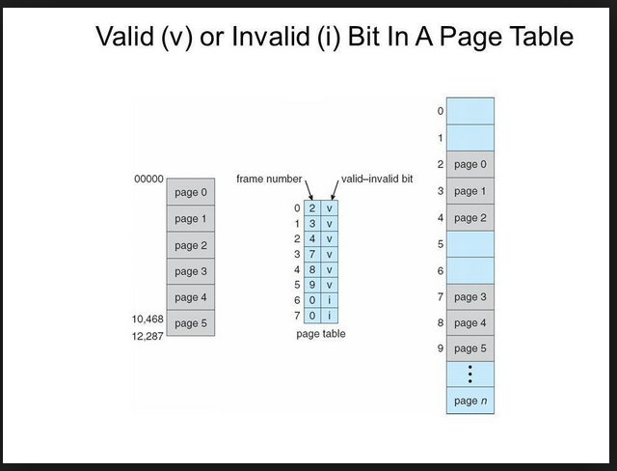

Slide 71
Segmentation
Segmentation is a memory-management scheme that supports user view of memory and contains segment.
In below fig. we can see that memory is divided into multiple segments like, subroutine, stack, code, heap, etc.

Slide 72

Segmentation (Cont’d..)
Users or programmers specify each address by 2 quantities: a segment name & an offset. (contrast to the paging)
For simplicity of implementation, segments are numbered and referred by segment no. rather than name.
So logical address consists of 2 tuple:
<segment-number, offset>
Here, Segment-number is used to identify a segment.
offset is an original location within a segment.
Segment 1
Segment
name
offset
Logical Address Space
- Collection of segments

Slide 74
Example of Segmentation

Slide 75
Hardware Implementation of
Segmentation
Logical address is 2D
Physical address is 1D
Thus, we must define an implementation that maps 2d into 1d.
This mapping is affected by a Segment Table.
Each entry of the segment table has Base and Limit. The segment base contains the starting address of the segment where as limit specifies the length of the segment.

Slide 76
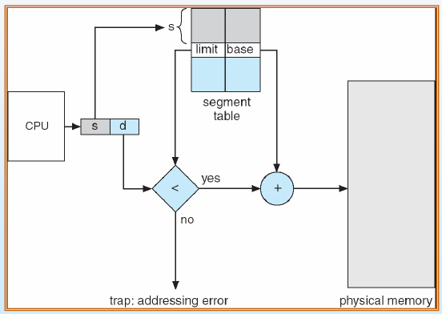
Hardware Implementation of
Segmentation (Cont’d..)

Slide 77
Hardware Implementation of
Segmentation (Cont’d..)
A logical address consists of 2 parts: s & d.
Here, S is used as an index into segment table
- D must be between 0 and segment limit.
- If its not, it will be trapped to OS.
For Example,
Segment 2 is 400 bytes long. Begins at 4300.
It will check 53 < 0 – limit ( i.e. 400)
Thus, a reference to byte 53 of segment 2 is mapped as
4300 + 53 = 4353.
now check for 1222 byte for segment 0 .
1222 < 0 – 1000 , which is false so it will be trapped to OS.

Slide 78
Difference between Segmentation and Paging
 | Segmentation | Paging
1 | Program is divided into variable size segments. | Program is divided into fix size of pages.
2 | Segmentation is slower than paging. | Paging is faster than segmentation.
3 | Segmentation is visible to the user. | Paging is invisible to the user.
4 | Segmentation eliminates internal fragmentation. | Paging suffers from internal fragmentation.
5 | Segmentation suffers from external fragmentation. | There is no external fragmentation.
6 | OS maintain a list of free holes in main memory. | OS must maintain a free frame list

Slide 79
Advantages of Segmentation
Segmentation is useful for memory management.
Using segmentation users can partition their programs into number of subtask i.e. modules which are operate independently from each another.
Segments increases data sharing between two processes.
Segmentation allows to extend the address ability of a processor
Segmentation provides facility to separate the memory areas for heap, code, stack, data, etc.

Slide 80
Disadvantages of Segmentation
In segmentation external fragmentation is mostly present.
Costly algorithm.
Segmentation finds free memory area big enough.
When we use paging it generates list of free pages.
Implementation is very complex.

Slide 81
Structure of Page Table
Hierarchical Paging (Multilevel Page Table).
Inverted Page Table.
Hashed Page Table.

Slide 82
Structure of Page Table
Hierarchical Paging (Multilevel Page Table).
Multilevel Paging is a paging scheme which consist of two or more levels of page tables in a hierarchical manner. It is also known as hierarchical paging.
The entries of the level 1 page table are pointers to a level 2 page table and entries of the level 2 page tables are pointers to a level 3 page table and so on.
The entries of the last level page table are stores actual frame information.
Level 1 contain single page table and address of that table is stored in PTBR (Page Table Base Register).

Slide 83
A logical address (on 32-bit machine with 1K page size) is divided into: - a page number consisting of 22 bits - a page offset consisting of 10 bits Since the page table is paged, the page number is further divided into: - a 12-bit page number - a 10-bit page offset (p2)
Two-Level Paging Example

Slide 84
Thus, a logical address is as follows: page number page offset 12 10 10 where, - p1 is an index into the outer page table, - p2 is the displacement within the page of the inner page table Known as forward-mapped page table
Two-Level Paging Example
p1
p2
d

Slide 85
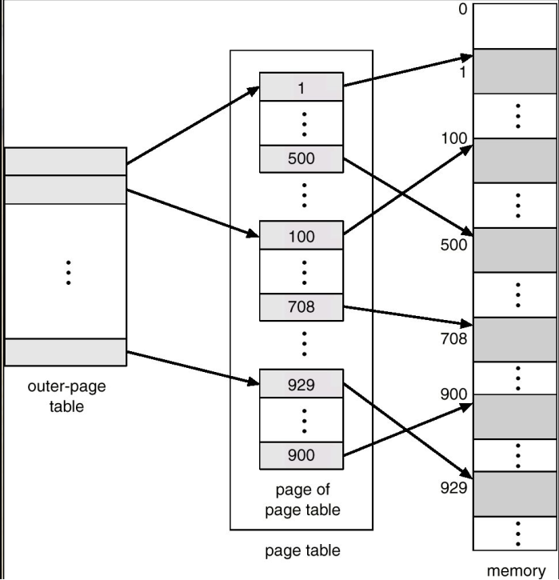
Two-Level Page-Table Scheme

Slide 86
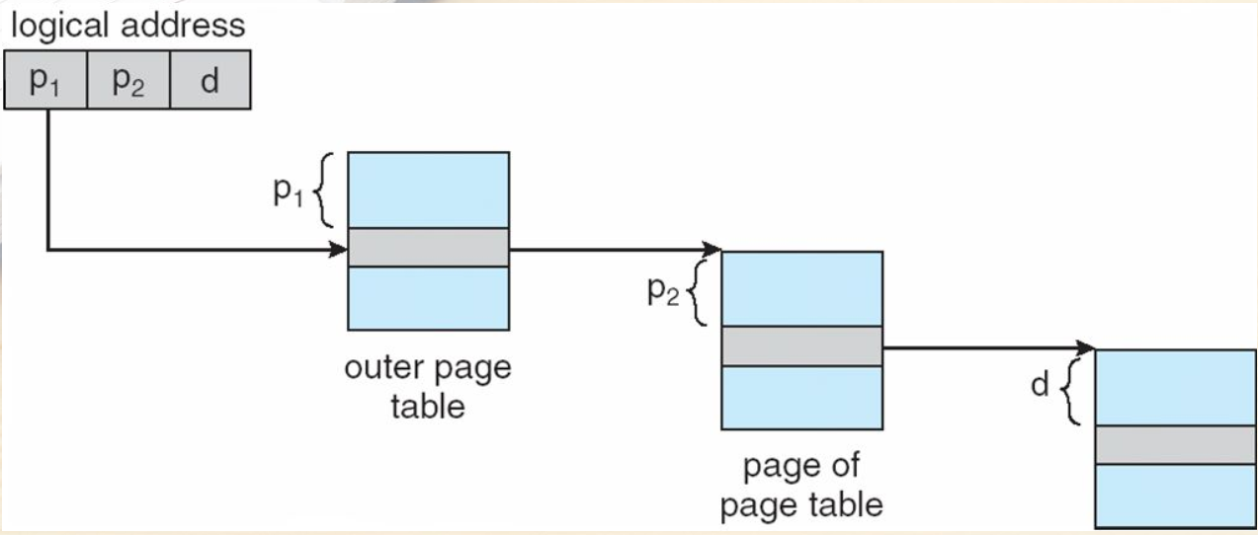
Address-Translation Scheme

Slide 87
2) Hashed Page Table
Common in address spaces > 32 bits
The virtual page number is hashed into a page table - This page table contains a chain of elements hashing to the same location
Each element contains (1) the virtual page number (2) the value of the mapped page frame (3) a pointer to the next element
Virtual page numbers are compared in this chain searching for a match - If a match is found, the corresponding physical frame is
extracted

Slide 88
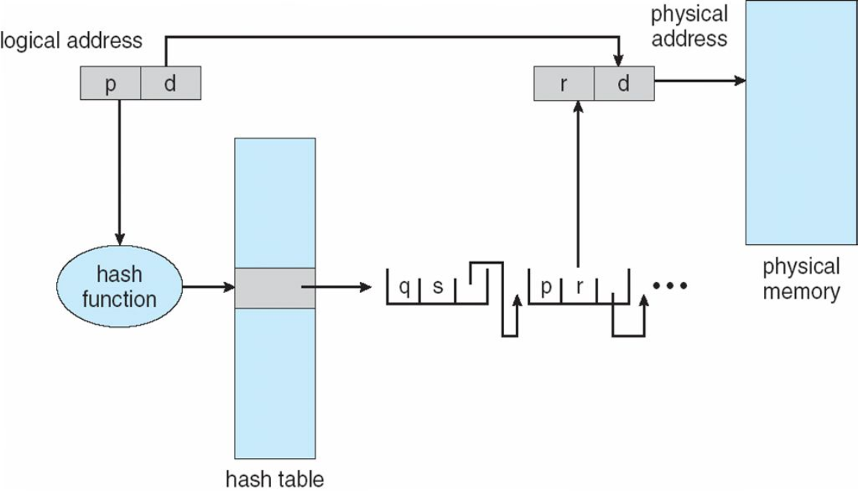
Hashed Page Table (Cont’d..)

Slide 89
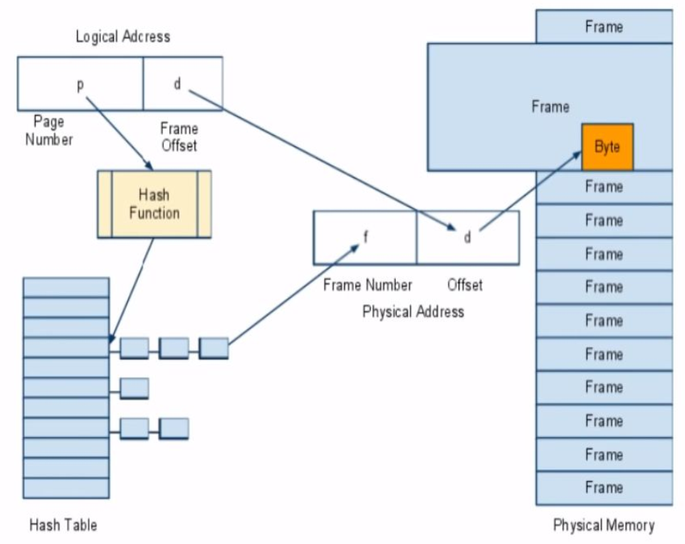
Hashed address translation

Slide 90
3) Inverted page table
Rather than each process having a page table and keeping track of all possible logical pages, track all physical pages.
Inverted page table has one entry for each real page (or frame) of memory.
Entry consists of the virtual address of the page stored in that real memory location, with information about the process that owns that page (Table stores the corresponding pid and page no. )
Decreases memory needed to store each page table, but increases time needed to search the table when a page reference occurs

Slide 91
3) Inverted page table (Cont’d..)
Requires the linear search of the entire table to perform the translation from page to frame. But it is inefficient in terms of performance.
Use hash table to limit the search to one — or at most a few — page-table entries - TLB can accelerate access

Slide 92
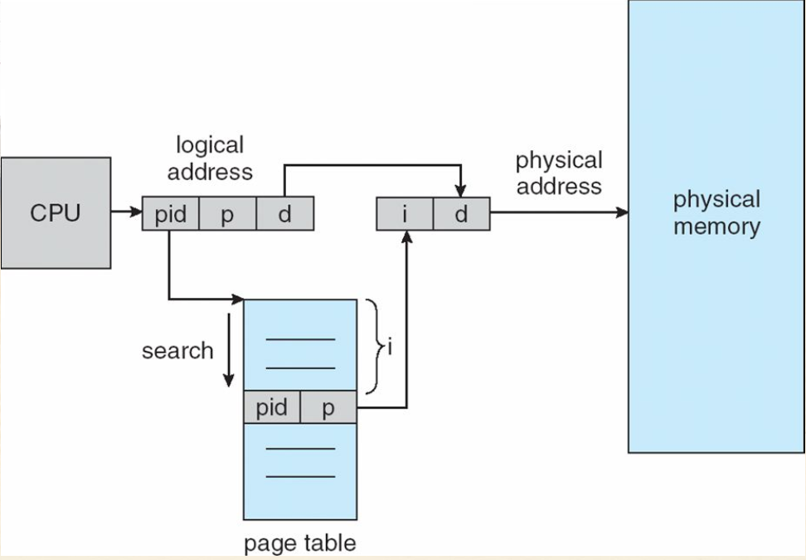
Inverted Page Table Architecture

Slide 93
Virtual Memory
The goal of the virtual memory is to keep many processes in execution.
It is a technique that allows the execution of processes those are not completely in main memory.
In real time the size of programs are very large. So it is difficult to store whole program in main memory.
To solve this problem Virtual Memory is used.
V.M. is provides space to store large programs in form of pages.
When programs are in execution then only the required pages or portions of processes are loaded into the main memory.
This technique is useful when we have small physical memory and program size is very large.

Slide 94
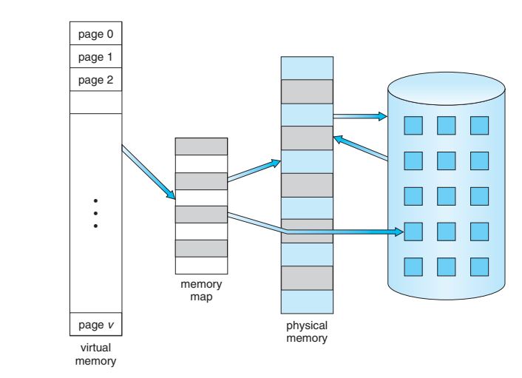
Virtual Memory (Cont’d..)
Fig. Diagram showing virtual memory that is larger than physical memory

Slide 95
Virtual Memory (Cont’d..)
Advantages of Virtual Memory:-
Virtual memory helps to gain speed when only a particular segment of the program is required for the execution of the program.
It is very helpful in implementing a multiprogramming environment.
It allows you to run more applications at once.
It helps you to fit many large programs into smaller programs.

Slide 96
Virtual Memory (Cont’d..)
Advantages of Virtual Memory (Cont’d..):-
Common data or code may be shared between memory.
The code can be placed anywhere in physical memory without requiring relocation.
More processes should be maintained in the main memory, which increases the effective use of CPU.
Each page is stored on a disk until it is required after that, it will be removed.

Slide 97
Virtual Memory (Cont’d..)
Disadvantages of Virtual Memory:-
If the system is using virtual memory then applications running speed is slower down.
It will takes more time to perform switching between applications.
Hard drive space is reduced.
It reduces system stability.
It allows larger applications to run in systems that don't offer enough physical RAM alone to run them.
It doesn’t perform same as RAM.
It negatively affects the overall performance of a system.
Occupy the storage space, which may be used otherwise for long term data storage.

Slide 98
Locality of reference
Locality of reference refers to a phenomenon in which a computer program tends to access same set of memory locations for a particular time period.
In other words, Locality of Reference refers to the tendency of the computer program to access instructions whose addresses are near one another.
The property of locality of reference is mainly shown by loops and subroutine calls in a program.

Slide 99
Locality of reference (Cont’d..)
It is based on the principle of locality of reference. There are two ways with which data or instruction is fetched from main memory and get stored in cache memory. These two ways are the following:
Temporal Locality
Spatial Locality
[2]

Slide 100
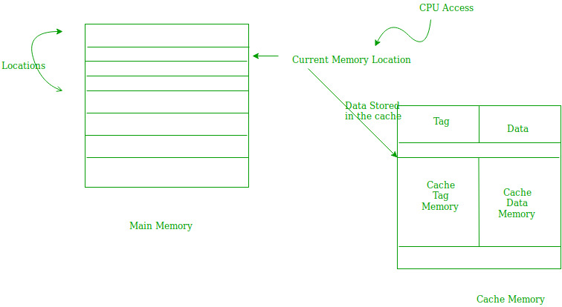
Locality of reference (Cont’d..)
Temporal Locality – Temporal locality means current data or instruction that is being fetched may be needed soon. So we should store that data or instruction in the cache memory so that we can avoid again searching in main memory for the same data.
[2]

Slide 101
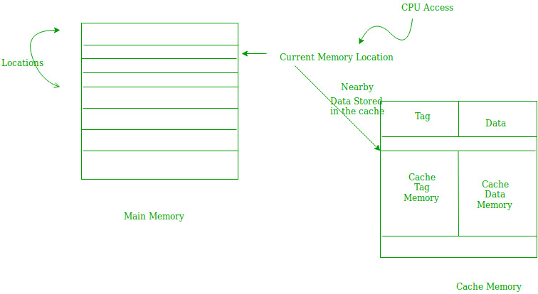
Locality of reference (Cont’d..)
Spatial Locality –
Spatial locality means instruction or data near to the current memory location that is being fetched, may be needed soon in the near future. This is slightly different from the temporal locality. Here we are talking about nearly located memory locations while in temporal locality we were talking about the actual memory location that was being fetched.
[2]

Slide 102
Page Fault
When the process tries to access a page that was not brought into memory, it causes a Page Fault.
When process tries to get the page which valid/invalid bit is set to invalid, indicates the page is not loaded to memory, lazy pager generates the page fault to the operating system.
So later on that page should be brought to the main memory

Slide 103
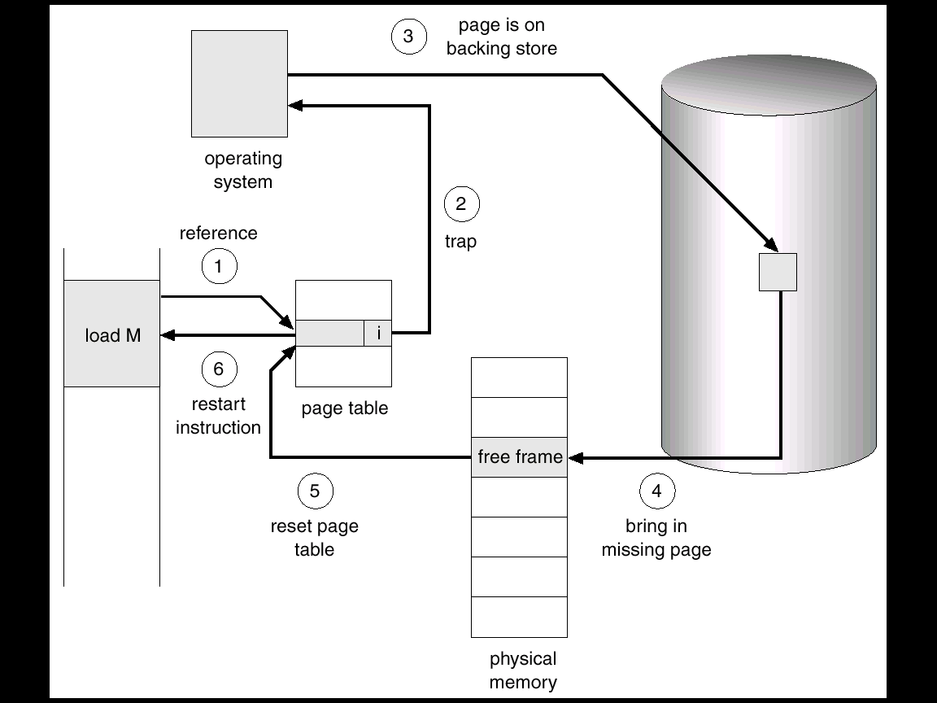
Steps in Handling a Page Fault

Slide 104
Steps in Handling a Page Fault (Cont’d..)
We check an internal table for this process, to determine whether the reference was a valid or invalid memory access.
If the reference was invalid, we terminate the process. If it was valid, but we have not yet brought in that page, we now page it in.
We find a free frame.
We schedule a disk operation to read the desired page into the newly allocated frame.
When the disk read is complete, we modify the internal table kept with the process and the page table to indicate that page is now in memory.
We restart the instruction that was interrupted by the illegal address trap.

Slide 105
Dirty Pages
Dirty pages are the pages in memory (page cache) that have been rationalized and consequently have changed from what is currently stored on disk.
This usually happens when an existing file on the disk is altered or appended.

Slide 106
Dirty Bits/ Modified Bits
In order to reduce the page fault service time, a special bit called the dirty bit can be associated with each page.
A dirty bit or modified bit is a bit that is associated with a block of computer memory and indicates whether or not the corresponding block of memory has been modified.
Dirty bits are used by the CPU cache and in the page replacement algorithms of an operating system.

Slide 107
Dirty Bits/ Modified Bits (Cont’d)
The dirty bit is set to “1” by the hardware whenever the page is modified (written into).
When we select a victim by using a page replacement algorithm, we examine its dirty bit.
If it is set, that means the page has been modified since it was swapped in. In this case we have to write that page into the backing store.
However if the dirty bit is reset, that means the page has not been modified since it was swapped in, so we don’t have to write it into the backing store. The copy in the backing store is valid.

Slide 108
LECTURE OVERVIEW
concepts of paging
concepts of demand paging
Review paging and page replacement
page replacement algorithms a. Optimal b. FIFO c. NFU d. NRU e. LRU
Conclusion
References

Slide 109
What is Paging?
The OS divides virtual memory and the main memory into units, called “pages”.
Each used page can be either in secondary memory or in a page frame in main memory.
A frame does not have to comprise a single physically contiguous region in secondary storage.

Slide 110
concepts of demand paging:
According to the concept of Virtual Memory, in order to execute some process, only a part of the process needs to be present in the main memory which means that only a few pages will only be present in the main memory at any time.
However, deciding, which pages need to be kept in the main memory and which need to be kept in the secondary memory, is going to be difficult because we cannot say in advance that a process will require a particular page at particular time.
Therefore, to overcome this problem, there is a concept called Demand Paging is introduced. It suggests keeping all pages of the frames in the secondary memory until they are required. In other words, it says that do not load any page in the main memory until it is required.
Whenever any page is referred for the first time in the main memory, then that page will be found in the secondary memory.

Slide 111
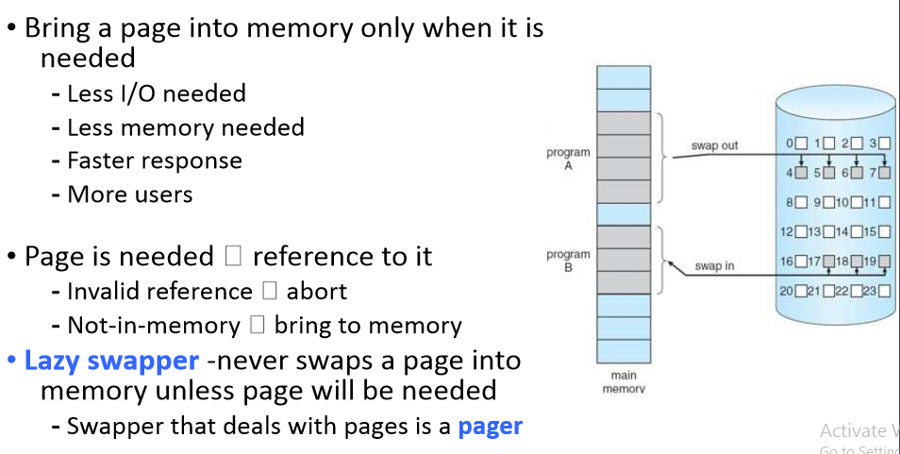
demand paging

Slide 112
Page Fault
If there is a reference to a page, first reference to that page will trap to operating system: page fault
Operating system looks at another table to decide: - Invalid reference abort
Get empty frame
Swap page into frame
Reset tables
Set validation bit = v
Restart the instruction that caused the page fault

Slide 113
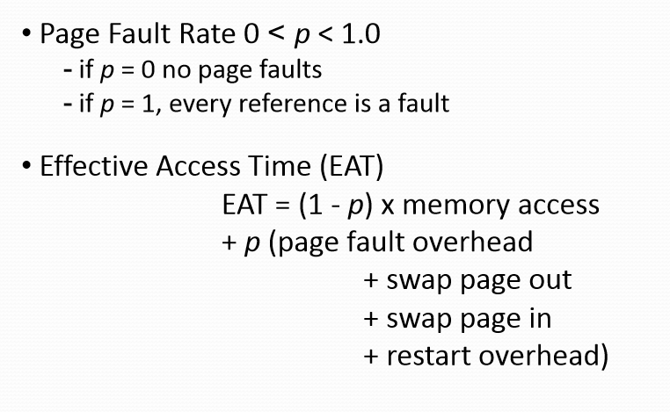
Performance of Demand Paging

Slide 114
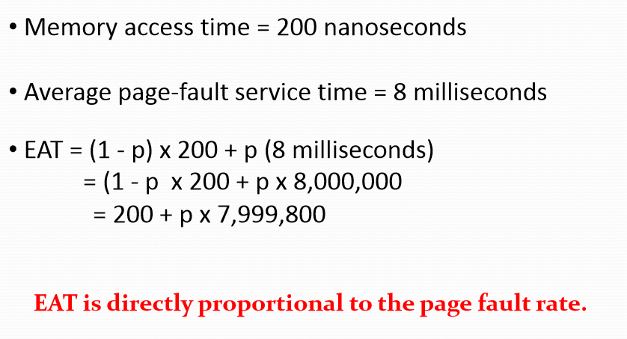
Demand Paging Example

Slide 115
HARDWARE SUPPORT
The hardware to support demand paging is the same as the hardware forpaging and swapping:
PAGE TABLE : This table has the ability to mark an entry invalid through a valid invalid bit or a special valueof protection bits.
SECONDARY MEMORY : The memory holds those pages that are not present in the main memory. The secondary memory is usuallya high speed disk. It is known as Swap Device and the section of the disk used forthis purpose is known as the Swap Space.

Slide 116
What happens if there is no free frame?
Page replacement - find some page in memory, but not really in use, swap it out - Algorithm - Performance - want an algorithm which will result in minimum number of page faults
Same page may be brought into memory several times

Slide 117
What is page replacement?
When memory located in secondary memory is needed, it can be retrieved back to main memory.
Process of storing data from main memory to secondary memory ->swapping out
Retrieving data back to main memory ->swapping in

Slide 118
Page Replacement
Find the location of thedesired pageon thedisk.
Find a free frame : ✓ If there is a free frame, use it. ✓ If there is no free frame, use a page replacement algorithm to selectavictim frame. ✓ Write the victim frame to the disk, change the page and frame tablesaccordingly.
Read the desired page into the newly freed frame, change the pageand frametables.
Restart theuserprocess.

Slide 119
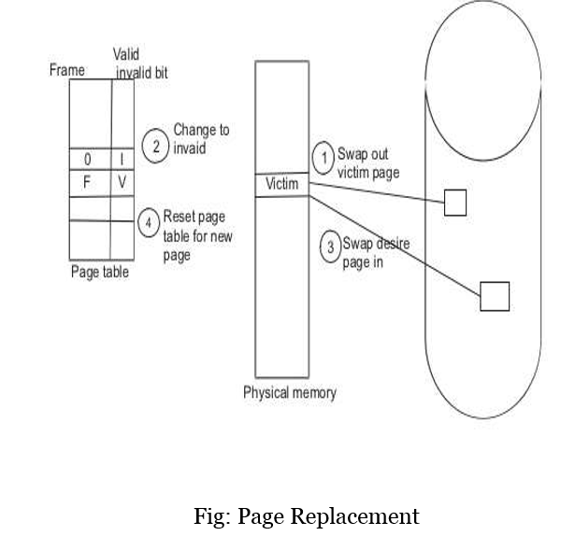

Slide 120
STEPS IN PAGE REPLACEMENT :
Find the location of thedesired pageon thedisk.
Find a free frame : ✓ If there is a free frame, use it. ✓ If there is no free frame, use a page replacement algorithm to selectavictim frame. ✓ Write the victim frame to the disk, change the page and frame tablesaccordingly.
Read the desired page into the newly freed frame, change the pageand frametables.
Restart theuserprocess.

Slide 121
What are Page Replacement Algorithms?
Deals with which pages need to be swapped out and which are the ones that need to be swapped in
The efficiency lies in the least time that is wasted for a page to be paged in

Slide 122
Why we need a page replacement algorithm?
The main goal of page replacement algorithms is to provide lowest page fault rate.

Slide 123
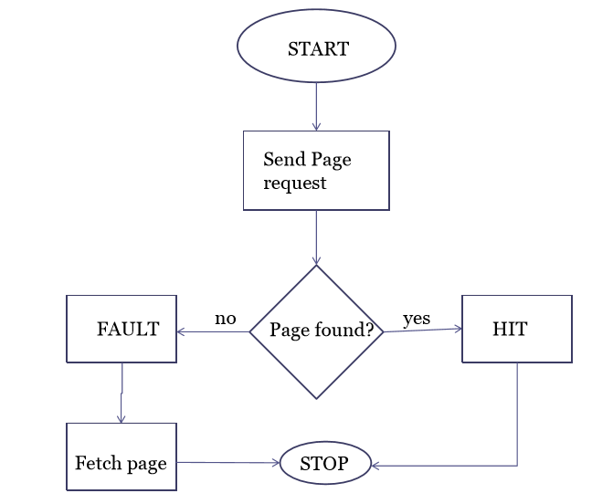

Slide 124
Page Replacement Algorithms
Want lowest page-fault rate • Evaluate algorithm by running it on a particular string of memory references (reference string) and computing the number of page faults on that string
• In all our examples, the reference string is
7,0,1,2,0,3,0,4,2,3,0,3,2,1,2,0,1,7,0,1

Slide 125
FIFO page replacement
Simplest page replacement algorithm
FIFO: First In First Out
Associate with each page the time when that page was brought into memory
When page must be replaced oldest page is chosen.
We can create a FIFO queue to hold all pages in memory.
We replace page at the head of the queue.
When page is brought into memory we replace insert it at the tail of the queue
For our example of reference string we consider three frames.
These three frames are initially empty.
FIFO page replacement works as below

Slide 126
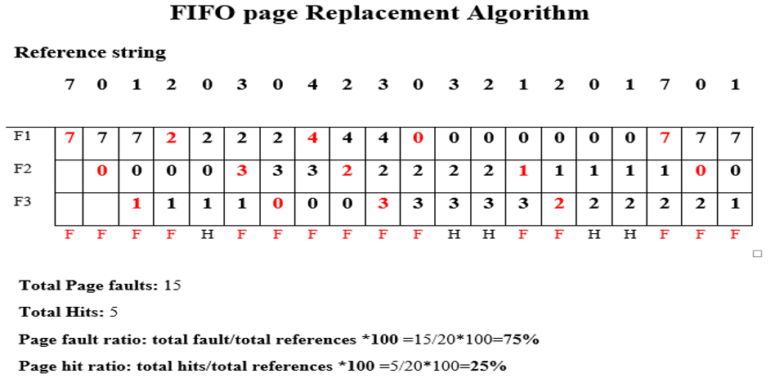

Slide 127
Drawbacks - FIFO
A page which is being accessed quite often may also get replaced because it arrived earlier than those present
Ignores locality of reference. A page which was referenced last may also get replaced, although there is high probability that the same page may be needed again.

Slide 128
Optimal Page replacement
Optimal page replacement has lowest page fault rate of all algorithms will never suffer from Baladys Anomaly.
“replace the page that will not be used for longest period of time”
Difficult to implement because it requires future knowledge of reference string.

Slide 129
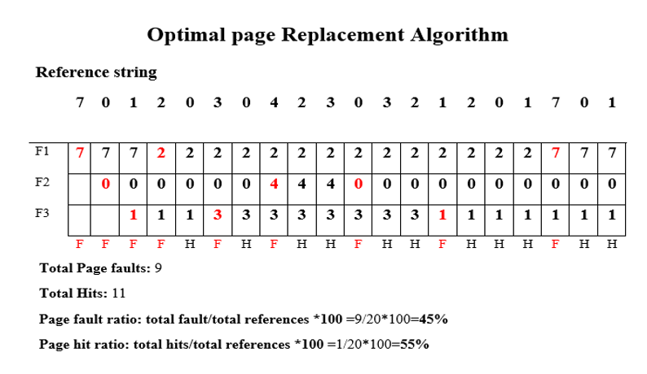

Slide 130
LRU Page Replacement
LRU: Least Recently Used
FIFO: uses when page is brought into memory.
Optimal: Uses time when a page to be used.
Replace a page that has not been usedfrom longest period of time.
When a page must be replaced, LRU choses a page that has not been used from longest period of time.
Looking backward in time.

Slide 131
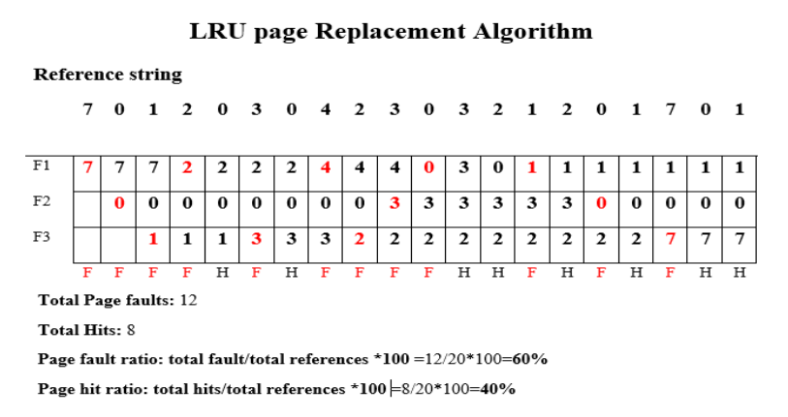

Slide 132
LRU Approximation u
Few computer system provides sfficient hardware support for LRU page replacement.
Some system provide no hardware support and other page replacement algorithm must be used.
Many system provide reference bits.
Reference bit is set by hardware whenever page is referenced.
reference bit is associated with each entry in page table.
Initially bits are cleared (to0)by OS.
A user process executes the bit associated with each page referenced is set (to 1) by hardware.
After some time we determine which page have been used and have not been used by examining the reference bits.

Slide 133
Not Recently Used (NRU)
It favours keeping pages in memory that have been recently used.
The OS divides the pages into four classes based on usage during the last clock tick:
3. Referenced, modified
2. Referenced, not modified
1. Not referenced, modified
0. Not referenced, not modified

Slide 134
NRU
Pick a random page from the lowest category for removal
i.e. the not referenced, not modified pag

Slide 135
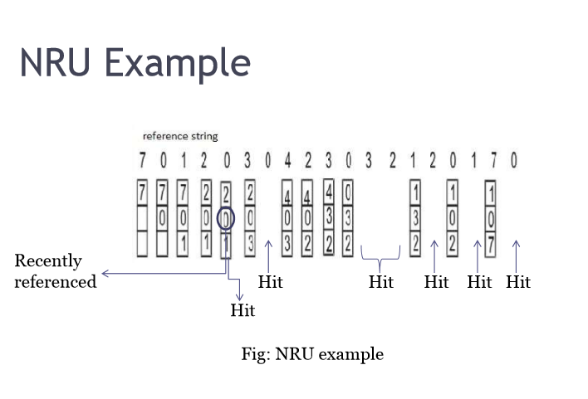

Slide 136
Not frequently used (NFU)
This page replacement algorithm requires a counter
The counters keep track of how frequently a page has been used
The page with the lowest counter can be swapped out

Slide 137
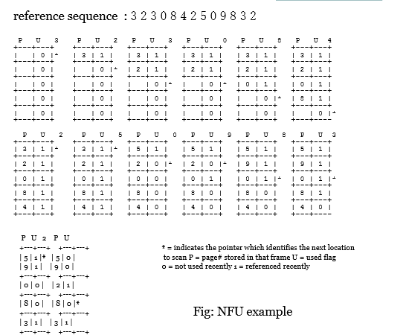

Slide 138
Conclusion
Algorithm Comment
FIFO Might throw out important pages
OPTIMAL Not implementable
LRU Excellent but difficult to implement
NRU Crude approximation of LRU
NFU Crude approximation of LRU

Slide 139
References:
1.Operating Systems: Internals and Design Principles, by William Stallings.
2.Operating Systems: Design and Implementation, Textbook by Andrew S. Tanenbaum.
3.Operating System Concepts by Galvin
4.Modern Operating Systems, Andrew S. Tanenbaum
5.Operating system concepts by Abraham Silberschatz.Peter B Galvin.Gerg
6.OPERATING SYSTEMS MEMORY MANAGEMENT by Jerry Breecher.

Slide 140
References
Books:-
[1] Operating System Concepts (6th Edition) by Silberschatz, Peter B. Galvin and Greg Gagne, Wiley-Indian Edition (2008).
Website:-
[2] https://www.geeksforgeeks.org/locality-of-reference-and-cache-operation-in-cache-memory/

Slide 141
References
Web Links
www.wikipedia.com
www.youtube.com
www.vbForum.com
• Papers
Operating System Page Replacement Algorithms by A. Frank C. Wersberg
• Books
Computer Organization & Architecture by William Stallings

Slide 142
THANK YOU…

